Slide 1


Factors affecting homicide rates in the US
Presented By:
Jesid Acosta
Hammad Muniem
Kavin Veerapandian

Slide 2

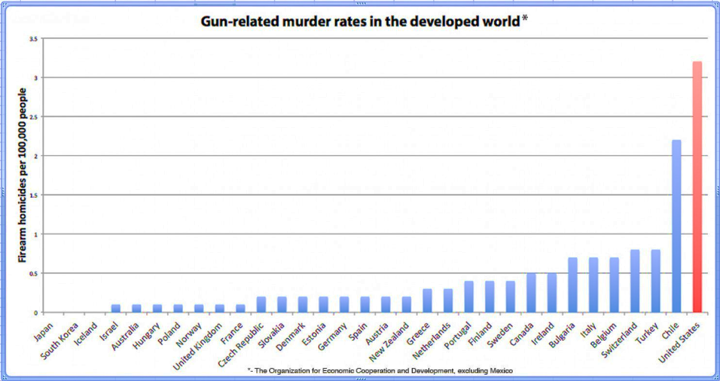
Significance in the US

Slide 3

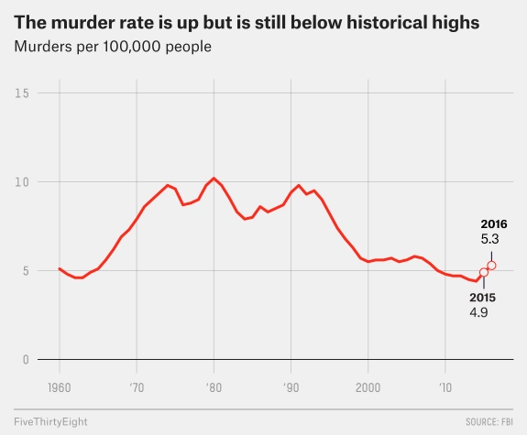
Homicides in the US

Slide 4
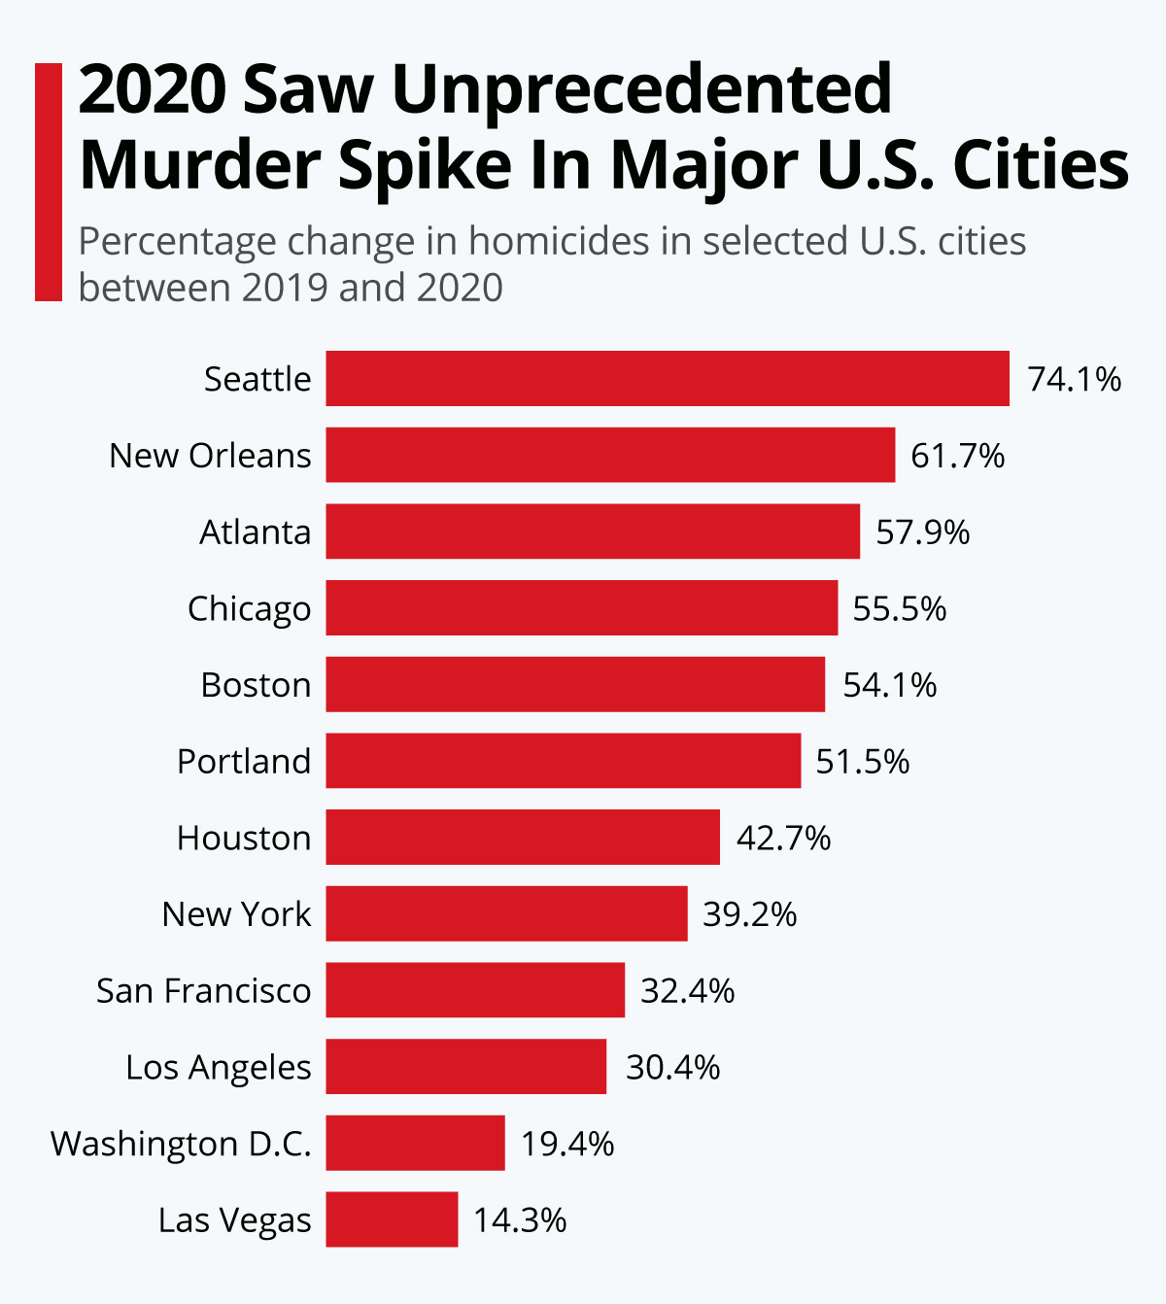
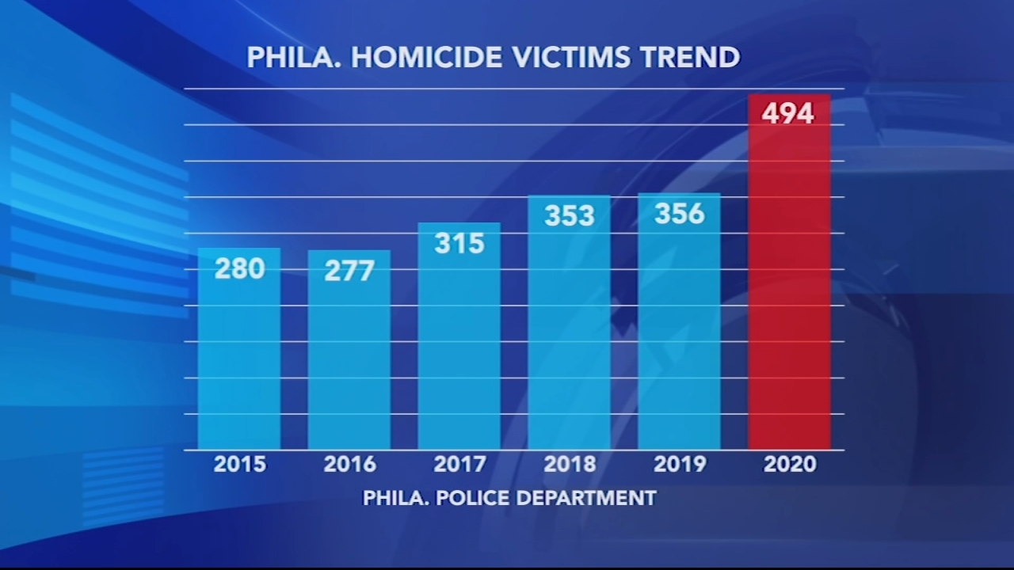
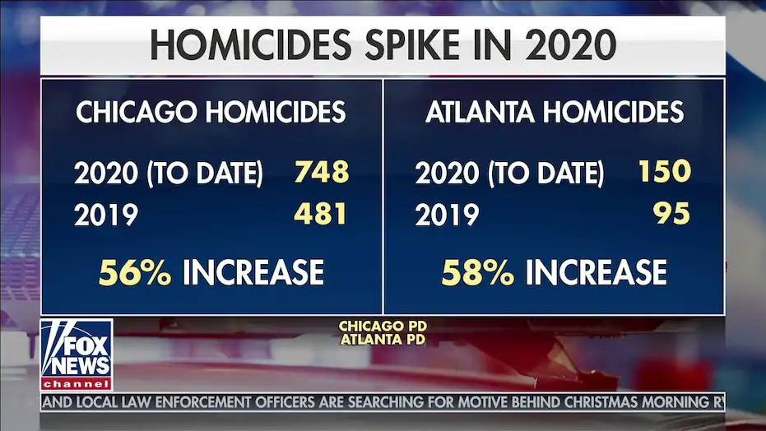
Homicide – Growing problem for the US

Slide 5
Why?
Every life is precious
Who?
State Legislative Members
What?
Factors contributing to high homicide rate
Notes:
Definition Homicide (FBI): “willful (nonnegligent) killing of one human being.”
All require the intention to kill, but they differ in terms of the degree of premeditation:
First Degree: a homicide that is both intentional and premeditated
Second Degree: the killing is intentional but lacks premeditation, because a person is provoked under circumstances likely to provoke any reasonable person and kills in the “heat of passion,”
Voluntary Manslaughter: depending on the degree of the mitigating circumstances

Slide 6
Literature Review
Article | Cause | Intervention
Wolfgang Stroebe (2015), Firearm Availability and Violent Death: The Need for a Culture Change in Attitudes toward Guns | increased gun availability: increases probability of intention of homicidal intent Increase probability of execution of homicidal intent: If guns were not available, the same distribution of homicidal intentions would result in considerably fewer homicides | A federal registration system for all firearms: help law enforcement keeps guns away from those prohibited from possessing them reduce illegal firearm sales and transfers Public health campaign emphasizing that gun ownership poses a risk to the owner as well as their family
Shane Darke (2009), The toxicology of homicide offenders and victims: A review | links between substance use and violence: Proximal: the direct psychopharmacological effects of a substance leads to propensity of violence Distant(lifestyle related): (i) ‘economic compulsive’ violence & (ii) ‘systemic’ violence that results from the dynamics of drug markets | Stable, prolonged treatment is associated with substantial reductions in drug use, crime and mortality. The individual is thus removed from the distal risk surrounding the drug market, as well as the proximal effects of substances limit the availability of firearms to psychostimulant users involved in drug markets

Slide 7
Literature Review
Article | Cause | Intervention
Firearm Laws and Firearm Homicides:A Systematic Review (JAMA Internal Medicine - 2017) | Firearm homicides are the leading cause of injury. Decreasing firearm availability appears to show decrease in homicides. | In the aggregate, stronger gun policies were associated with decreased rates of firearm homicide, even after adjusting for demographic and sociologic factors. Laws that strengthen background checks and permit-to-purchase seemed to decrease firearm homicide rates. Specific laws directed at firearm trafficking, improving child safety, or the banning of military-style assault weapons were not associated with changes in firearm homicide rates. The evidence for laws restricting guns in public places and leniency in gun carrying was mixed.
State gun laws, gun ownership, and mass shootings in the US_ cross sectional time series (BMJ 2019) | Predictors: year, state population, median household income, percent high school graduation, percent female, headed households, percent in poverty, percent unemployment, incarceration rate, percent white and restrictiveness-permissiveness score of state gun laws. States with more permissive gun laws and greater gun ownership had high rates of mass shootings. | States with more restrictive gun laws and greater gun ownership had lower rates of mass shootings.
The short-term and localized effect of gun shows: Evidence from California and Texas(MIT Press 2011) | Predictors: All gun deaths, gun suicides, gun homicides, demographic characteristics of ZIP codes, population, pop density, land area, fraction rural, fraction Hispanic, fraction black, fraction below poverty line, fraction of suicides by guns. | Results suggest that gun shows do not increase the number of homicides or suicides and that the absence of gun show regulations does not increase the number of gun related deaths as proponents of these regulations suggest.

Slide 8
Predictor Variables - 1
Name | Effect | Rationale
NumHomicides | NA | NA Dependent Variable (DV)
AnyOtherWeapon | + | Increase access in projectile weapons facilitates homicide intent into action
DestructiveDevice | No effect
Machinegun | + | Increase access in projectile weapons facilitates homicide intent into action
Silencer | No effect
ShortBarreledRifle | + | Increase access in projectile weapons facilitates homicide intent into action
ShortBarreledShotgun | + | Increase access in projectile weapons facilitates homicide intent into action
TotalWeapons |  | Increase in overall weapons facilitates by making tools for the act more available
NumDrugUsers | + | Psychoactive drugs in particular appear to show in significant amounts in homicidal events. Long-term treated patients also appear to be less likely to re-commit violent crimes.
NumAlcoholUsers | ++ | There is a high prevelance of alcohol usage in homicides. It has been shown that the rates of alcohols sales in some manner seem to correlate with the number of homicides
LawEnforcementOfficers | - | Increased precense in law enforcement may act as deterant from potential criminal activity (with a diminishing effect due to saturation)
LawEnforcementCivilians | No effect
TotalLawEnforcementEmployees | No effect
Population
RealGDPperCapita
Gini Index

Slide 9
Predictor Variables - 2
Name | Effect | Rationale
Violent Crime | NA | NA (Potential Additional DV - already includes homicides, partiality)
Property Crime | + | Increased levels of crime in an area may make it more permisible for more violent crime (broken windows theory)
Universal Background checks for all firearms | - | Background checks help prevent by firearms from getting into the hands of more prohibited purchasers and prevent gun violence that could be perpetrated by criminals who are able to purchase weapons.
Universal background checks for handguns | - | Background checks help prevent by handguns from getting into the hands of more prohibited purchasers and prevent gun violence that could be perpetrated by criminals who are able to purchase weapons.
Waiting Period for all firearms | - | Waiting periods could help firearms from getting into the hands of more prohibited purchasers immediately
Waiting period for handguns | - | Waiting periods could help handguns from getting into the hands of more prohibited purchasers immediately
Permit for all firearms | -
Permit for handguns | -
Permit for carrying concealed weapons | -
Ban on assault weapons | -
Background check in gunshows - firearms | -
Background checks in gunshows - handguns | -
SubAbuseInpatientCareBeds | - | As the number of treatment beds increases per state we can expect a decrease in alcohol or drug abuse which may lead to a decrease in homicides

Slide 10
Predictor Variables - 3
Name | Effect | Rationale
Serious Mental Illness | + | individuals with mental illness appear to have a higher propensity to be involved in potentially violent events that could lead to homicide, especially if interacting with other psychoactive substance
Unemployment rate
Big Cities | + | Cities may create greater returns to crime because criminals may have greater access to the wealthy and face a greater density of victims in urban areas.
Black | + | As per literature review, crime we expect that the proportion of African American population will be positively correlated with homicide rate.
Hispanic | + | Since there is a correlation between Hispanic origin and non-citizen status according to previous literature, we except a positive relation with homicide as well.
Asian | No effect
Area | No effect | Area won't directly affect homicide, but it might affect other factors like population density which should have a positive correlation with homicide rates
Education | - | With education, we expect the population to have better opportunities for higher income and hence, a decrease in violent crime
Non-Citizen | + | Since Non-citizen status doesn't permit legal jobs in most cases, it correlates directly with unemployment and hence should be positively correlated with homicide rate
Adults 19-25 | + | According to the Bereau of Justice Statistics, young adults are most vulnerable and perpetuators of violent crime including homicide

Slide 11






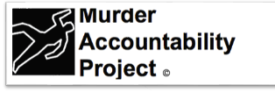

Data Sourcing

Slide 12
Next Steps:
What factors help reduce homicides?
Exploratory Data Analysis:
Dependent Variable (DV)
DV interaction with regressors – identify relationships between causes and interventions captured in model
Transformation:
Cleaning, Standardization & Feature Engineering
Explore appropriate model specifications
Notes:
Think further about our question:
Ways to skin the cat, compare state by state, look at changes overtime or a mix.

